Slide 3
JIF BLOOD DONATES

Slide 4
JIF BLOOD DONATES
NAME: | PROJECT TITLE:
J MOHAMED JABIR | BLOOD BANK MANAGEMENT SYSTEM

Slide 5


JUST QUICK SUMMARY OF THE PROJECT:
This is my “Blood Bank Management System” project where a user can
find all blood group types if any need, they can donate blood, they can
get blood from someone through this website.

Slide 6

Let’s get into the presentation…

Slide 7
LOGO
HOME BUTTON
ABOUT US
SIGN IN BUTTON
FOR NEW USER
LOGIN IF ALREADY REGISTERED

Slide 8

IT SHOWS ALL BLOOD TYPES AVAILABLE IN THE HOSPITAL WITH EMAIL ID
IF USER WANT TO DONATE THEIR BLOOD THEY CAN CLICK HERE
IF ANY PATIENTS NEED BLOOD THEY CAN APPPLY HERE

Slide 9
LET’S LOOK INTO A SMALL VIDEO OF MAIN PAGE

Slide 10
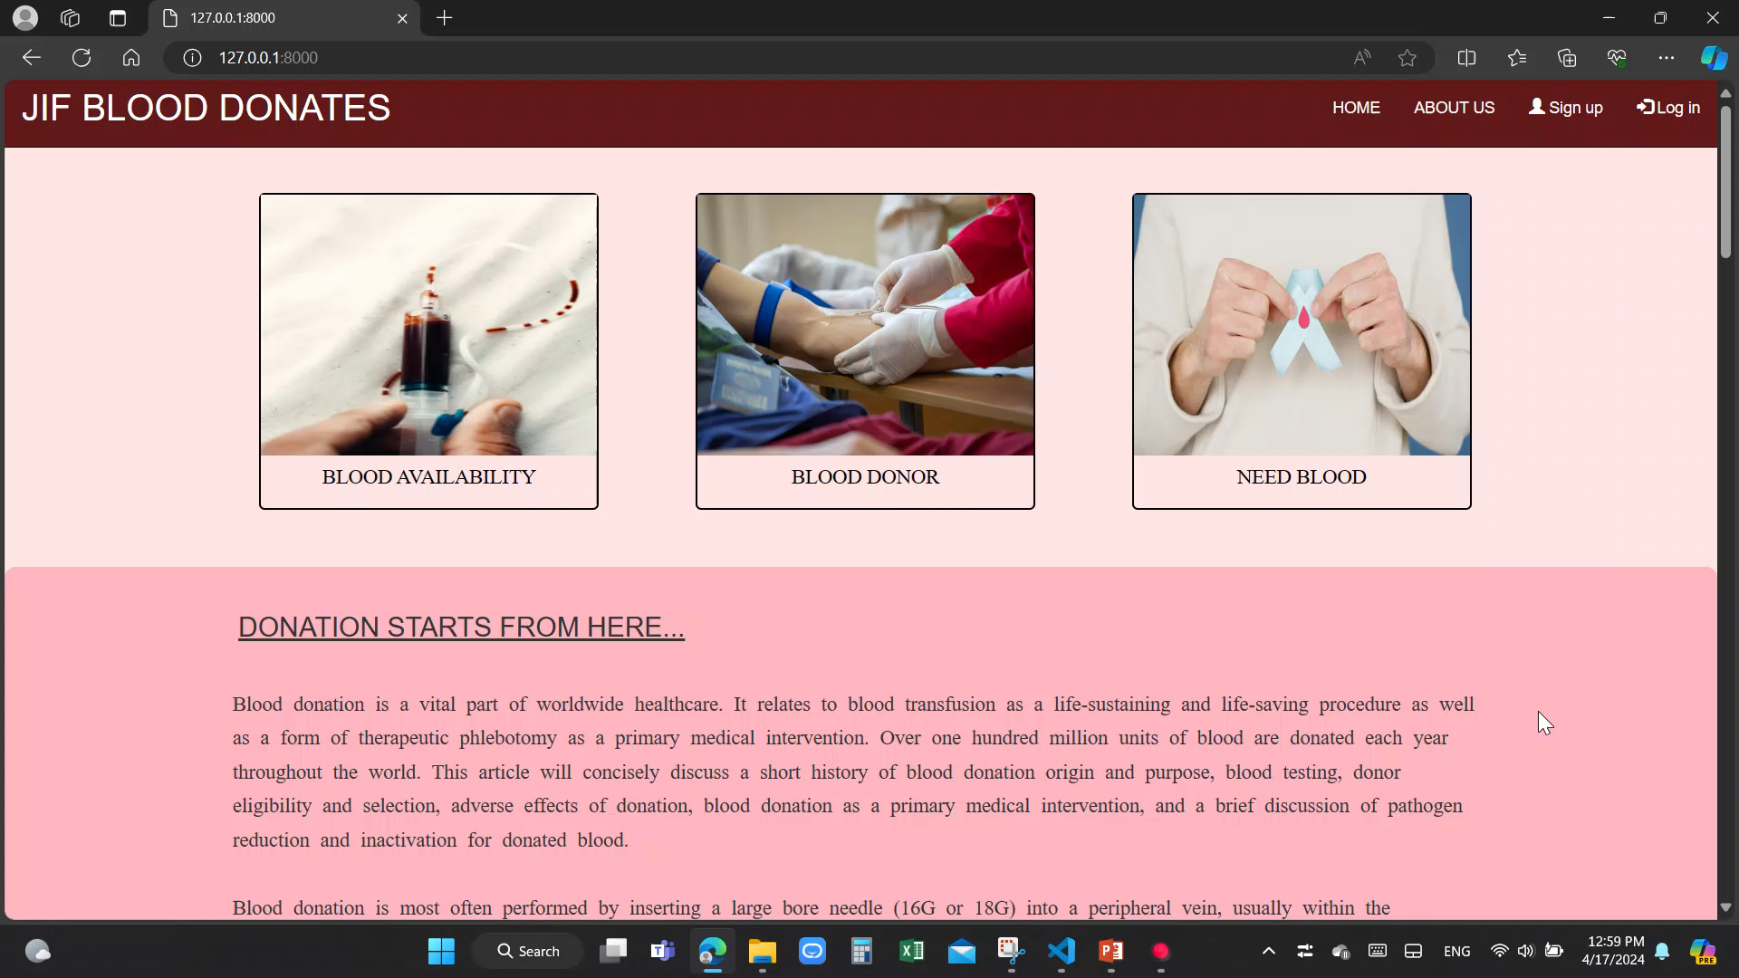

Slide 11
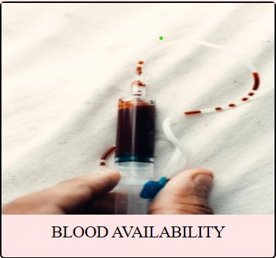

Slide 13
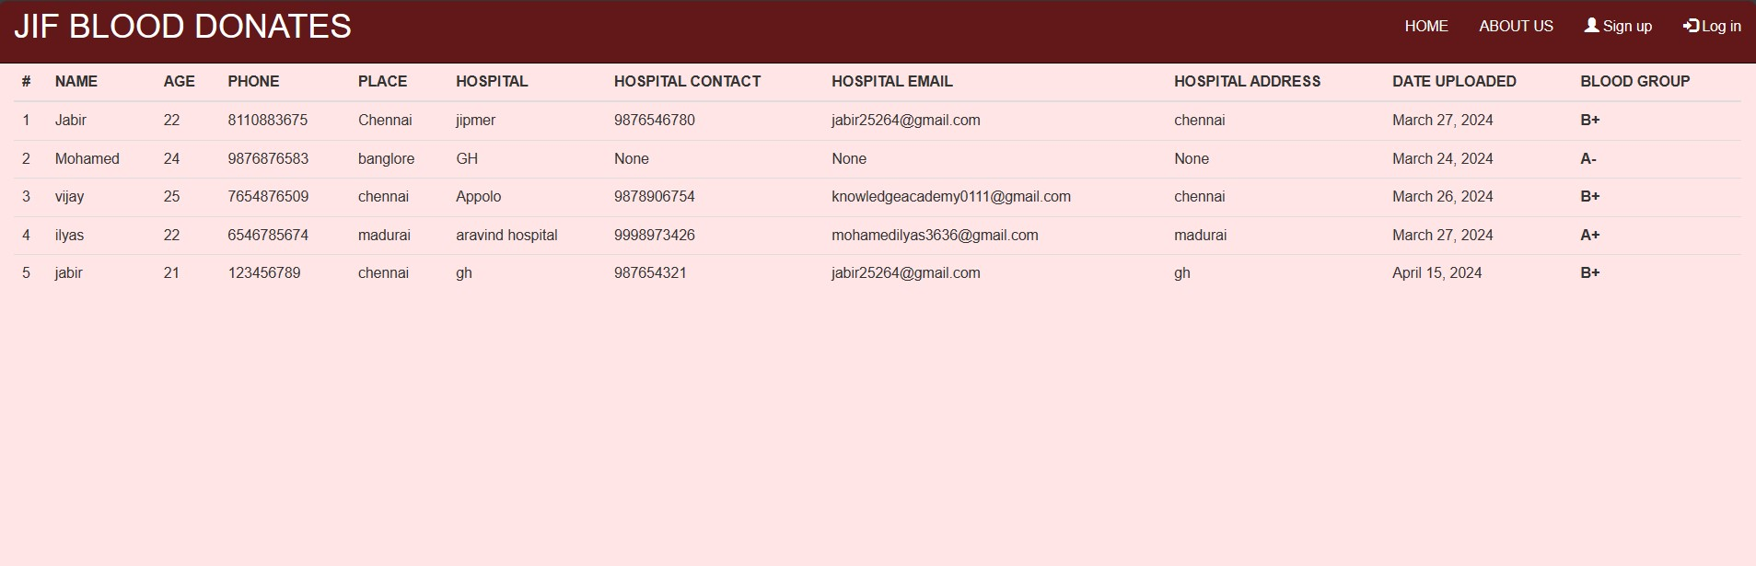
THE DATA SHOWN HERE ARE FETCHED FROM THE DATABASE

Slide 14
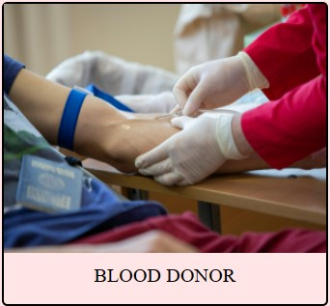

Slide 15
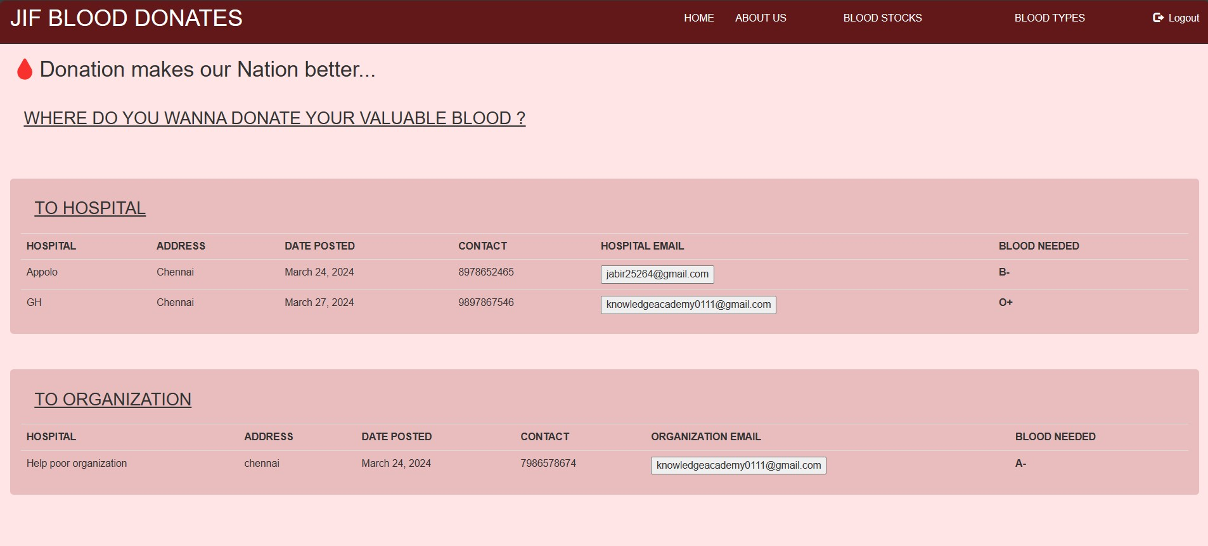
IF CONDITION
IF LOGIN
IF NOT LOGIN
AFTER LOGIN

Slide 16
USER CAN DONATE THEIR BLOOD WHERE THEY WANT TO DONATE
HERE USER CAN DONATE THEIR BLOOD TO HOSPITALS
USER CAN MAIL TO THE RESPECTIVE HOSPITAL/ORGANIZATION
HERE USER CAN DONATE THEIR BLOOD TO ORGANIZATION

Slide 17


Slide 18
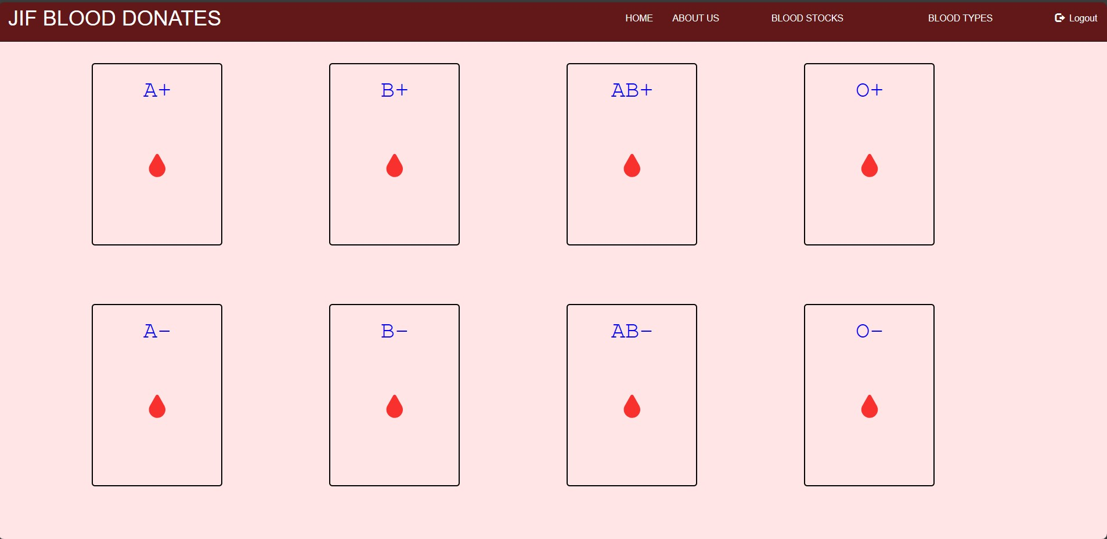
IF CONDITION
IF LOGIN
IF NOT LOGIN
AFTER LOGIN

Slide 19
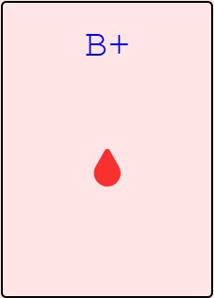
USER CAN REQUEST BLOOD GROUP ACCORDING TO THEIR NEED BY CLICKING ON THESE BUTTONS

Slide 20
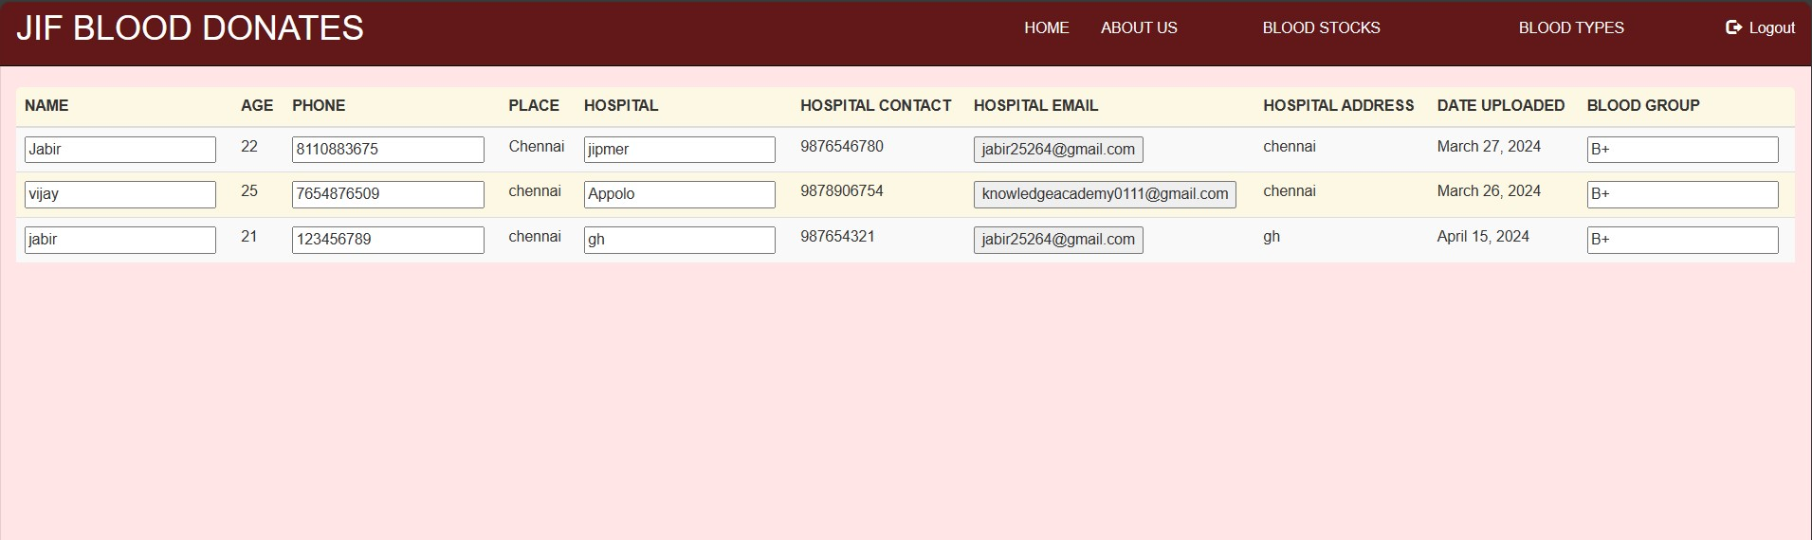
USER CAN REQUEST BLOOD BY CLICKING ON EMAIL BUTTON.
THE REQUEST WILL SEND TO HOSPITAL’S MAIL,THEN THE USER WILL GET NOTIFICATION FROM THE HOSPITAL IF REQUESTED BLOOD IS AVAILABLE

Slide 21
EVERY BOX HAS ITS DATA ABOUT BLOOD GROUP AND WITH PATIENT AND HOSPITAL NAME WHICH HAS BEEN FETCHED FROM DATABASE

Slide 22
THE END

Slide 23
THANK🤝 YOU

